Slide 1

MAJOR PROJECT EC17601 SESSION 2021-2022
PRIYANKA SONI (20185053)
DIVAS GUPTA (20185116)
DIPESH SHARMA POUDEL (20185105)

Slide 2

IMAGE CAPTION GENERATOR USING MACHINE LEARNING

Slide 3
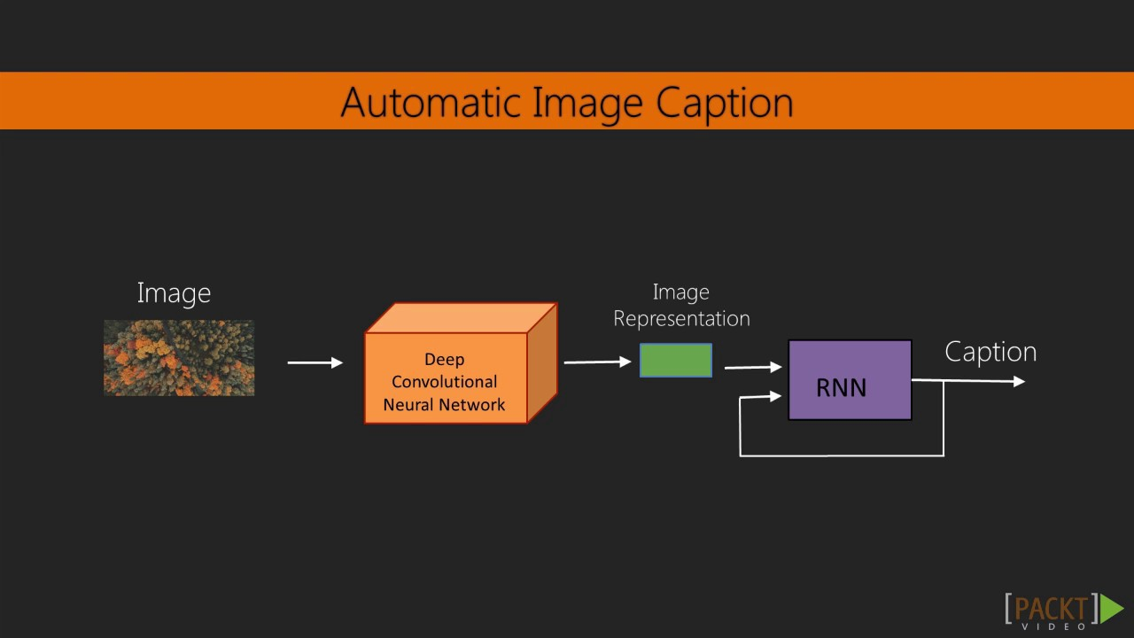
INTRODUCTION
Automatically generating natural language descriptions according to the content observed in an image, is an important part of scene understanding, which combines knowledge of computer vision and natural language processing.
Goal is to generate a concise description of an input image.

Slide 4
TECH STACKS
Python
TensorFlow
Keras (VGG16 model)
Numpy

Slide 5
DATASET (Flickr8k)
We are using Flickr8k Dataset for the project.
The dataset consists of 8000 images and each image has 5 corresponding descriptions.
We split the data into 6000,1000 & 1000 images as training , validation and testing sets respectively.

Slide 6
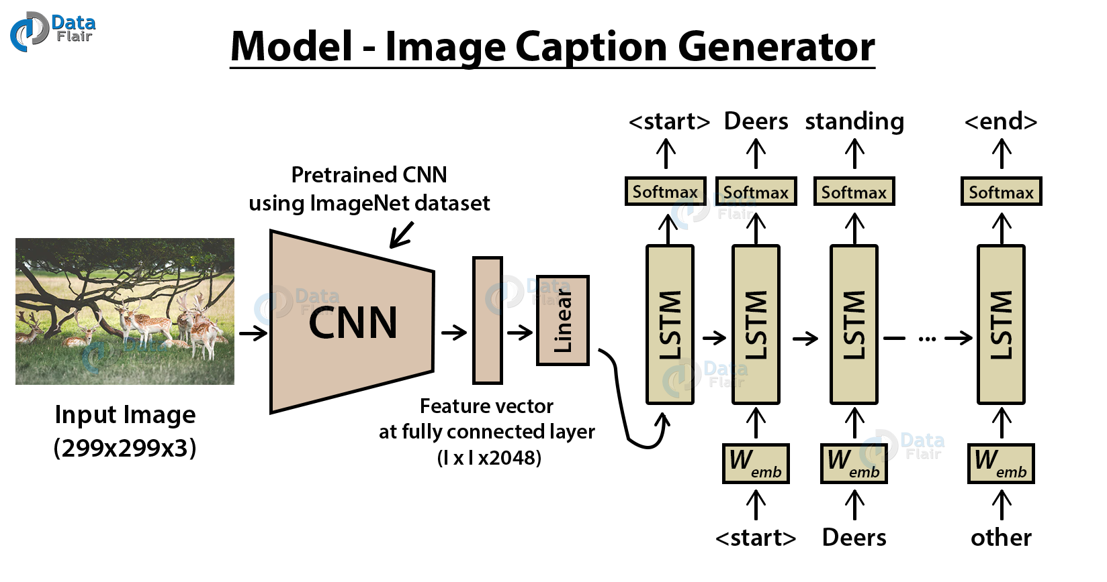
DEEP LEARNING MODEL
1.Image based model: We are using CNN to extract the features of an image.
2.Language based model: We are using LSTM to translates the features and objects extracted by image based model to a natural sentence.

Slide 7
IMAGE BASED MODEL
Resized all images to a fixed size of 224*224 pixels.
Used pre-built keras VGG16 (3*3 layers , CNN based ) 16 weighted layers model for features extraction of images.

Slide 8
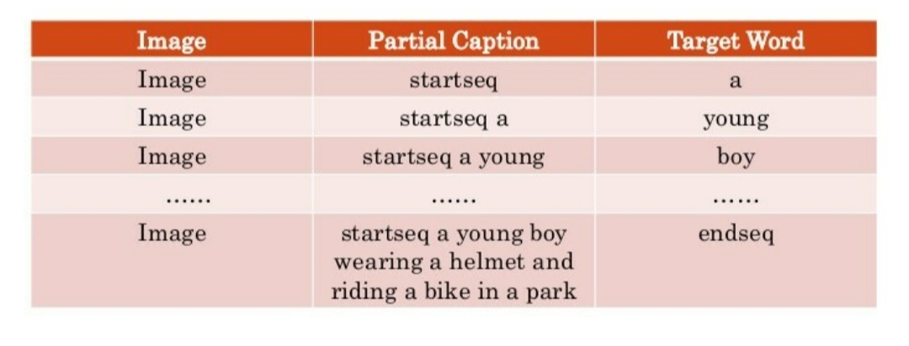
LANGUAGE BASED MODEL
For each image we trained the model by temporally injecting incremental sequences of the description.

Slide 9
EVALUTION METRICS
Bilingual Evaluation Understudy Score(BLEU)
BLEU is a metric for evaluating a generated sentence to a reference sentence
BLEU score lies between 0 to 1.
Result:-
Dataset: 6000 Descriptions: train=6000 Vocabulary Size: 7579 Description Length: 34 Dataset: 1000 Descriptions: test=1000 Photos: test=1000 BLEU-1: 0.529691 BLEU-2: 0.277107 BLEU-3: 0.182869 BLEU-4: 0.080318

Slide 10
RESULT

Slide 11
USES
IMAGE SEARCH ENGINE
GUIDANCE FOR BLINDS
SELF DRIVING CAR

Slide 12
FUTURE WORK

